Slide 1
River’s Edge at Dixie
Connor Nitterauer, Adam Franklin, Kashane Tiger, Kenny Cedeno

Slide 2
Agenda
Executive summary
Site analysis
Regulatory analysis
Market analysis
Proposed Design
Financial analysis
Conclusion
Questions

Slide 3
Executive summary

Slide 4
Site analysis

Slide 5
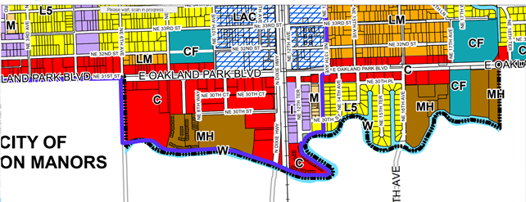
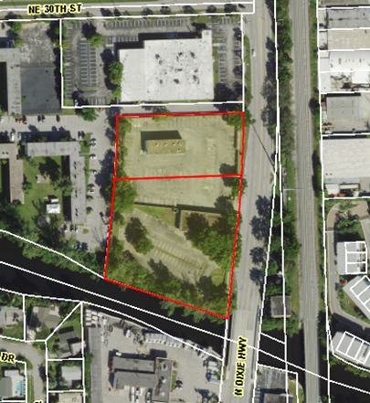
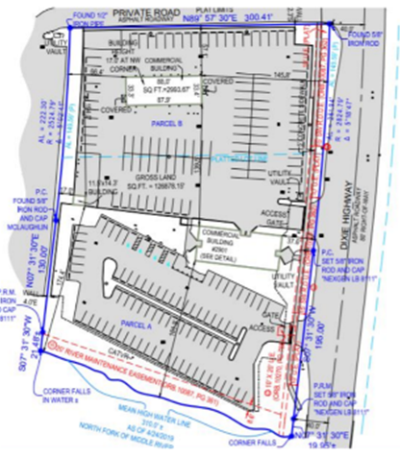
Site Analysis
Located on Dixie Highway and the North Fork Middle River
Consists on two parcels totaling 3 acres
Currently zoned B-2
Future Land Use Commercial

Slide 6
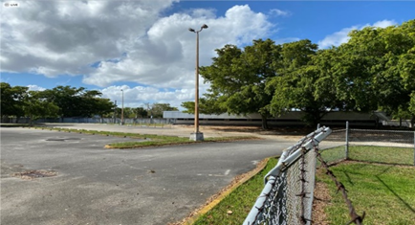
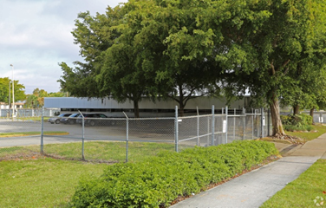
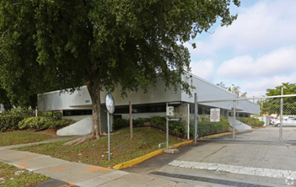
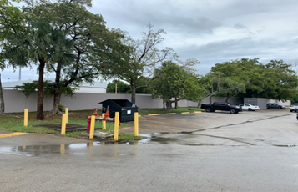
Existing conditions
Consist of existing structures totaling 6,748 SF
Total building value of $512,450
Most of the open area is for parking

Slide 7
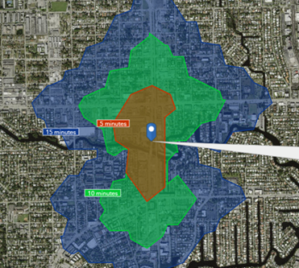
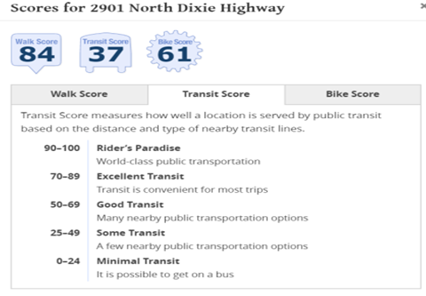
Walkability
As the distance expands, the amenities become drastically more abundant

Slide 8
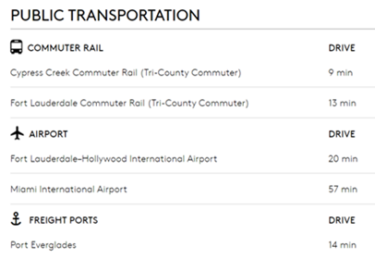
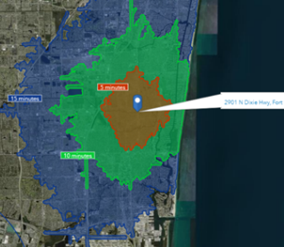
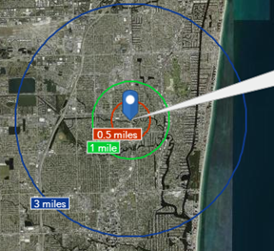
Accessibility
Relative ease of accessibility to major transportation hubs

Slide 9
Positives and Negatives
Positives:
The site is located relatively near all major transportation hubs
Walkability is reasonably good due to its proximity to parks
The site has potential as a new development area
The surrounding area is ideal for more redevelopment projects
Negatives:
Existing buildings will need to be demolished
The site is not located on a major intersection
Amenities near the site are not as appealing as other sites
The site can be redeveloped but the surrounding buildings will downplay the efforts to rehab the site effectively

Slide 10
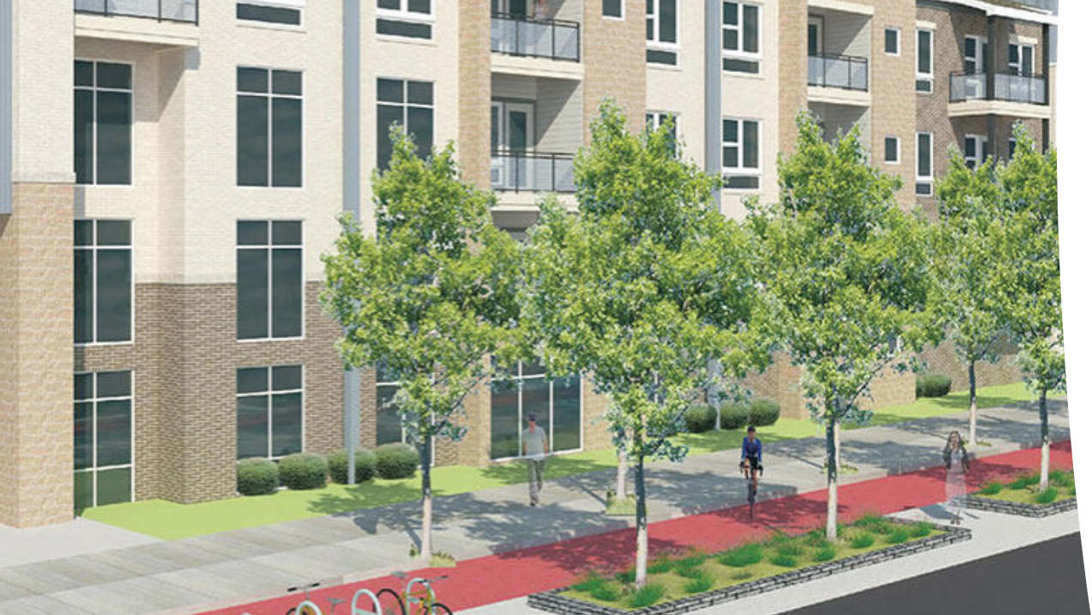
Regulatory analysis

Slide 11
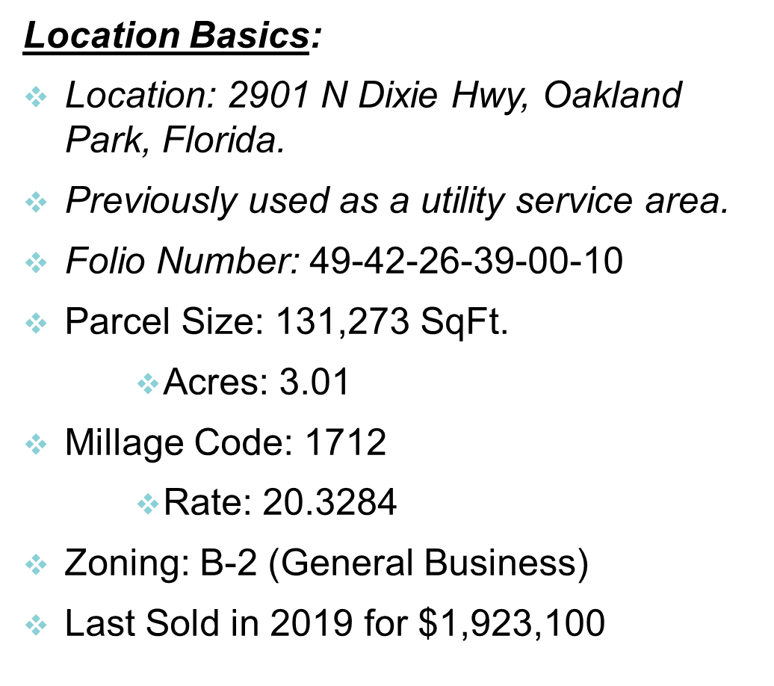
Location basics

Slide 12
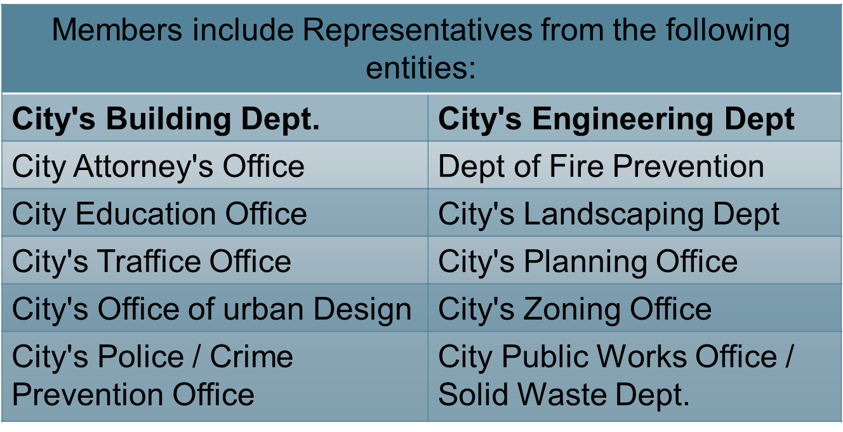
Development review committee

Slide 13
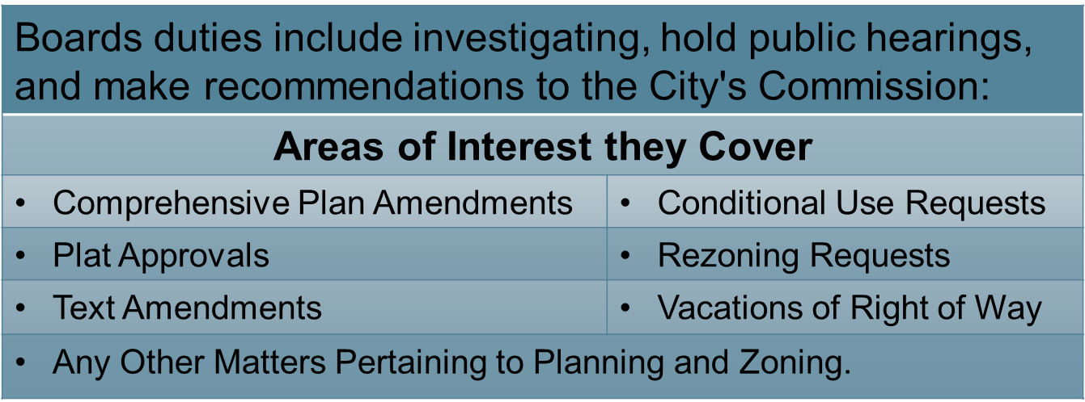
Planning & Zoning Board

Slide 14
Code Enforcement Board & Special Magistrate

Slide 15
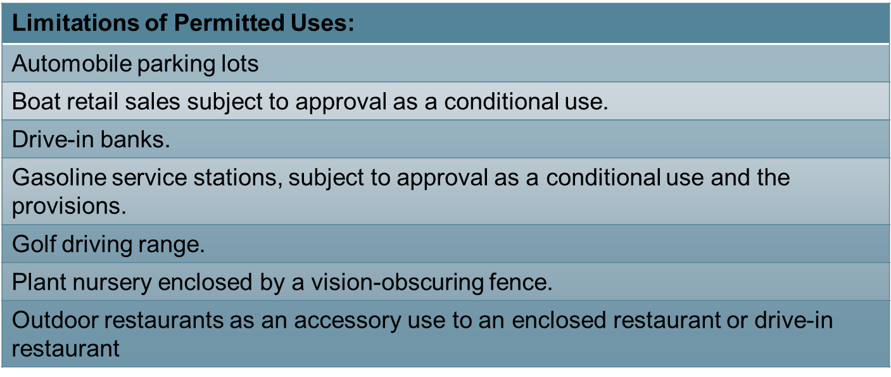
Zoning code

Slide 16
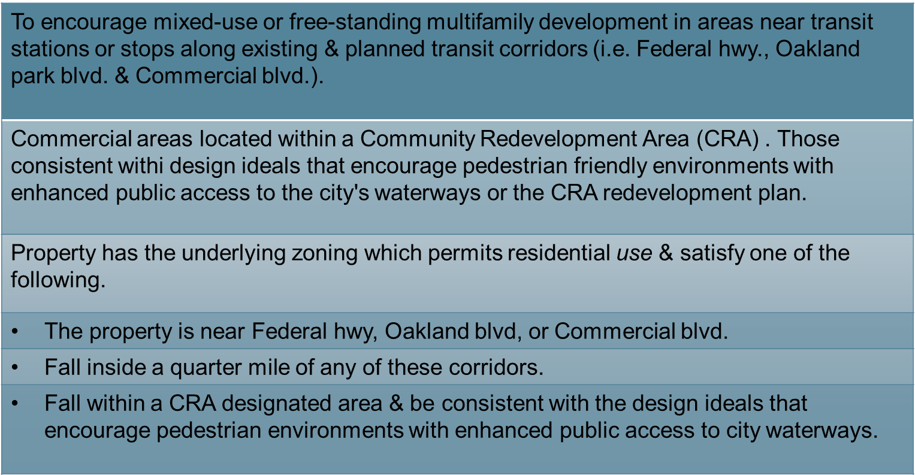
Mixed-use development

Slide 17
Market analysis

Slide 20
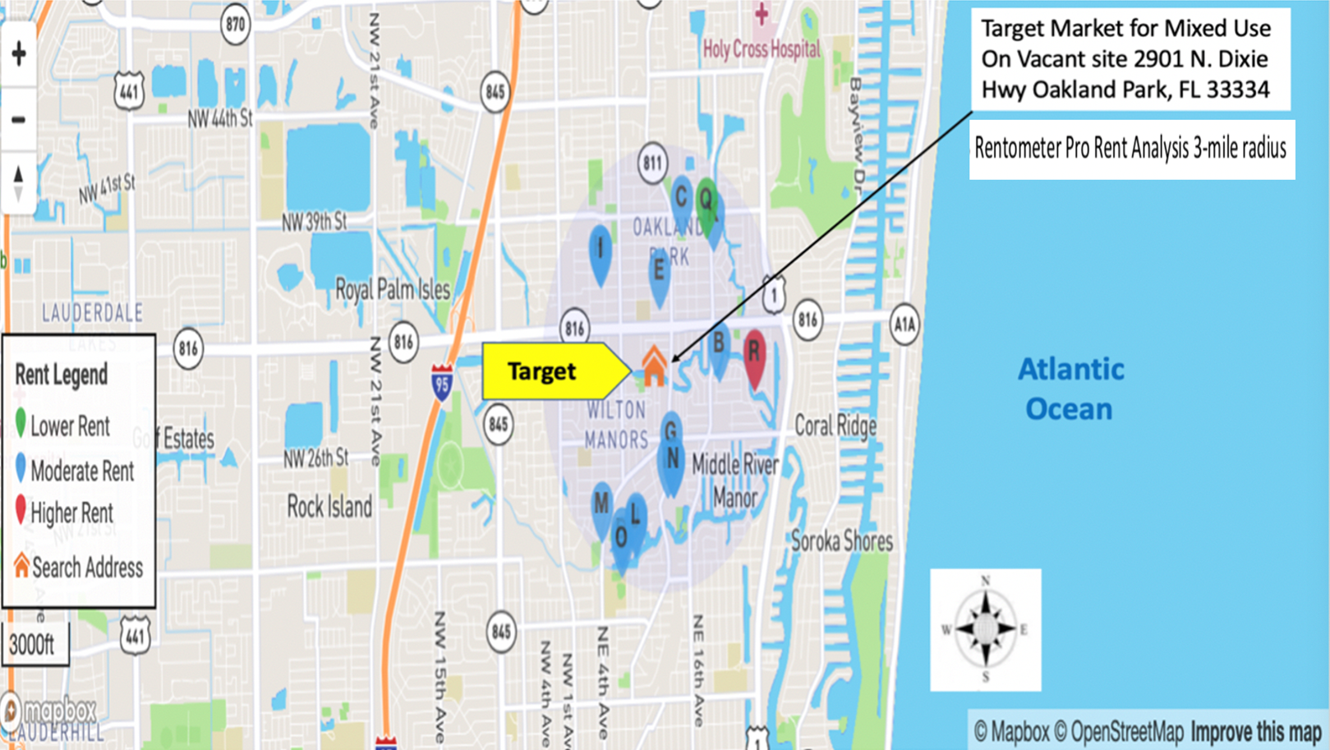

Slide 22
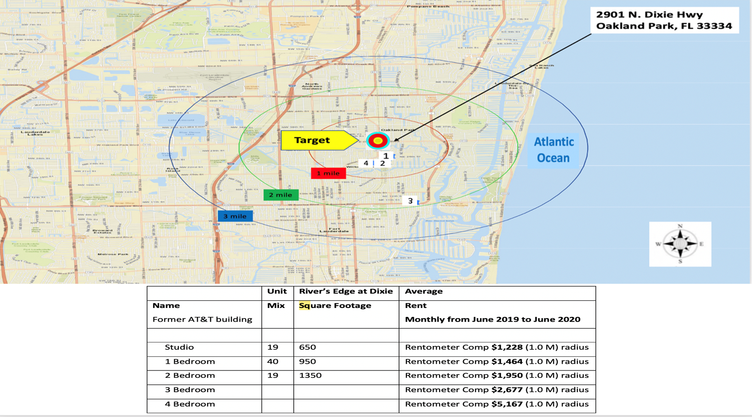

Slide 23
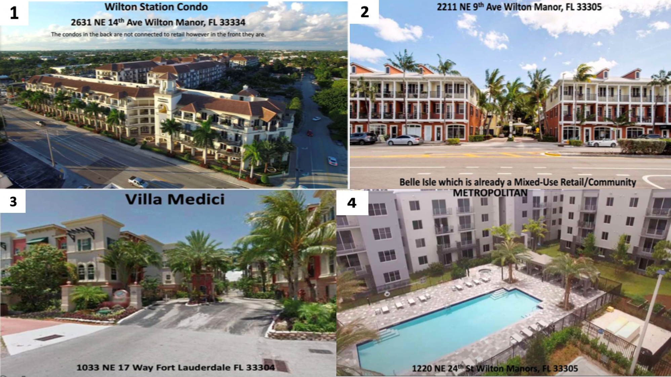

Slide 24
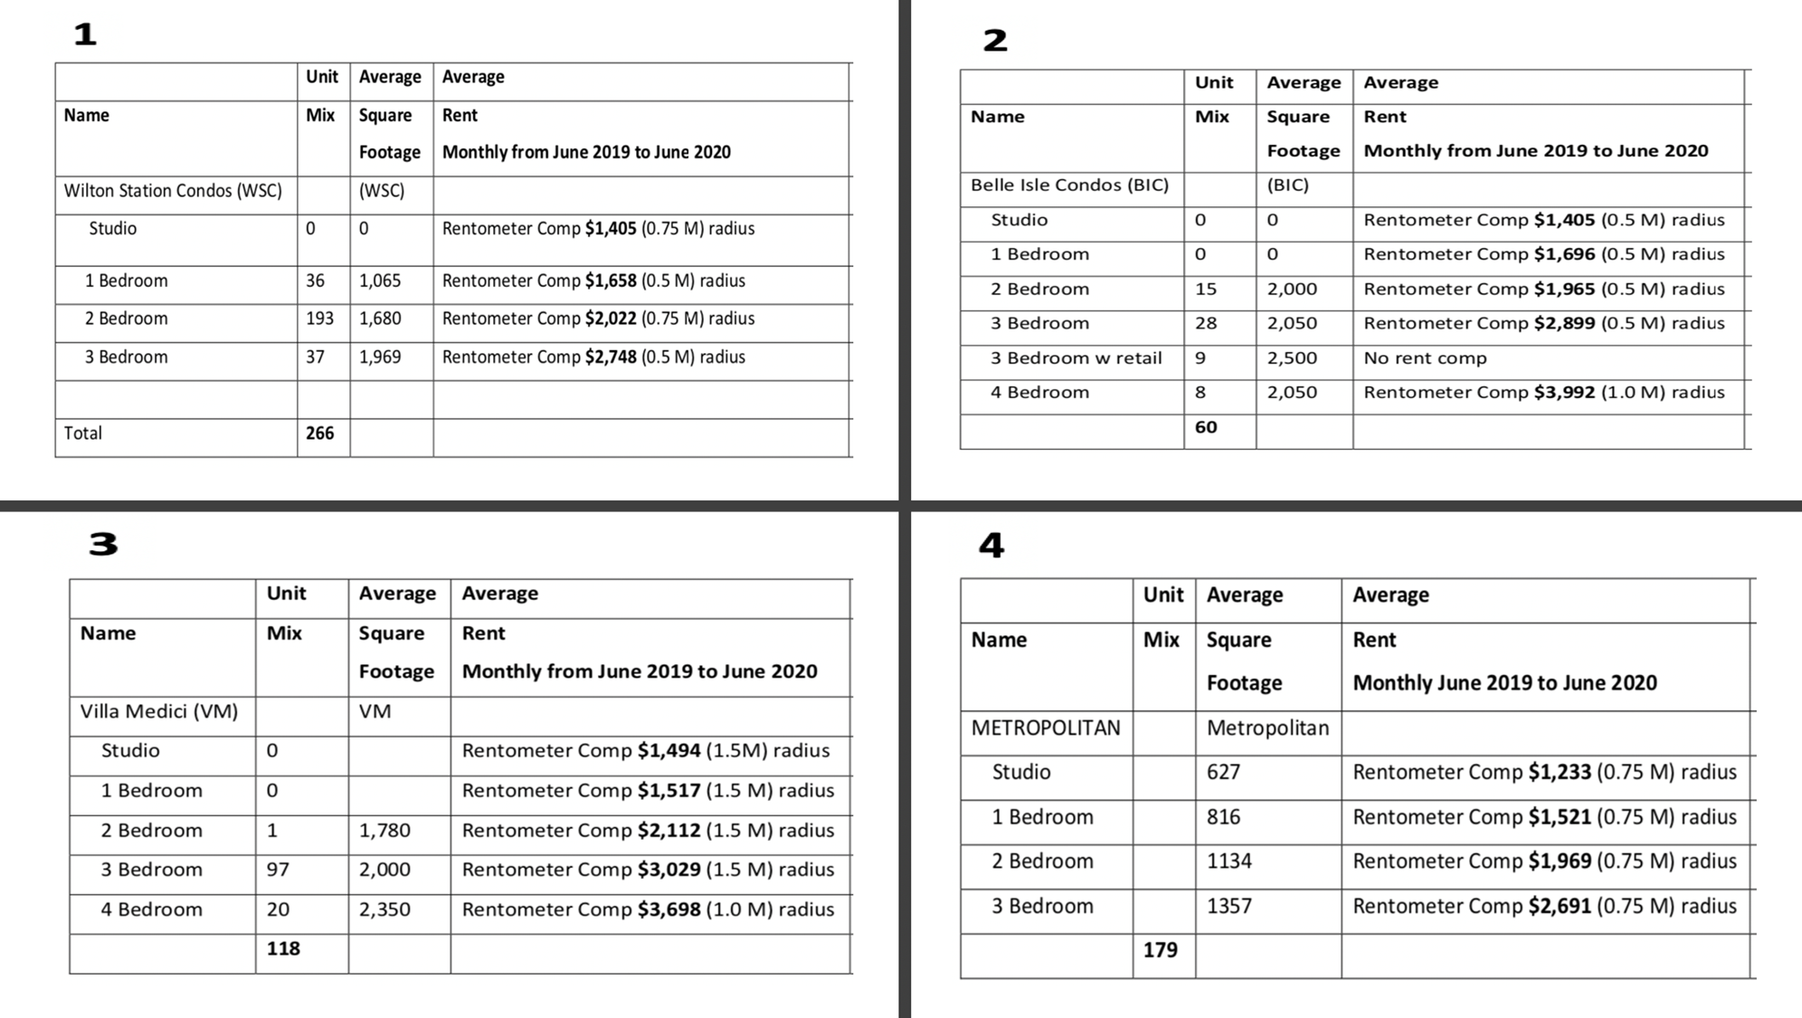

Slide 27
Trade area

Slide 28
Demographics

Slide 29
Demographics

Slide 30
Demographics

Slide 31
Demographics

Slide 32
Retail comparison

Slide 33
Traffic count

Slide 34
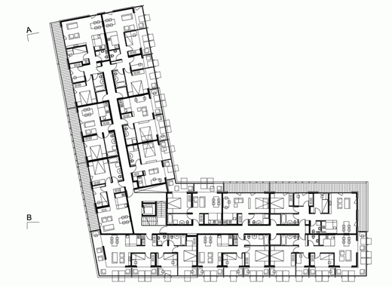
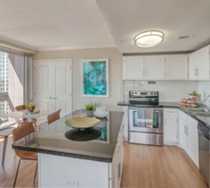
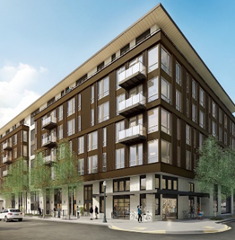
Proposed design

Slide 35
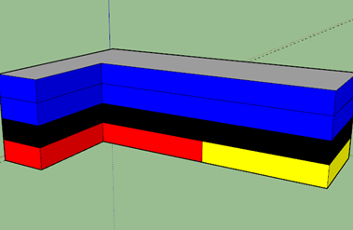
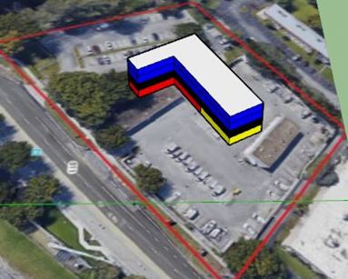
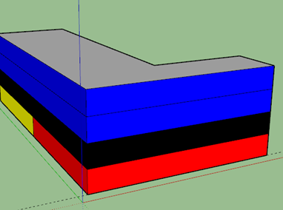
Proposed Design

Slide 36
Financial analysis

Slide 37
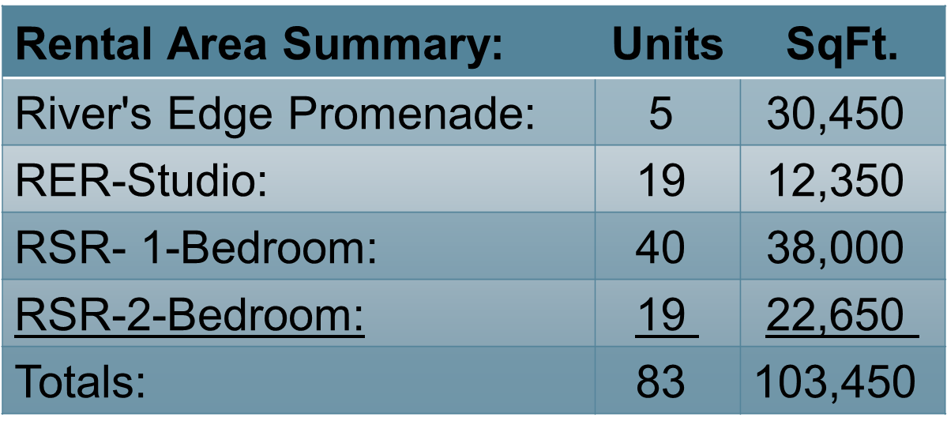
Space breakeout

Slide 38
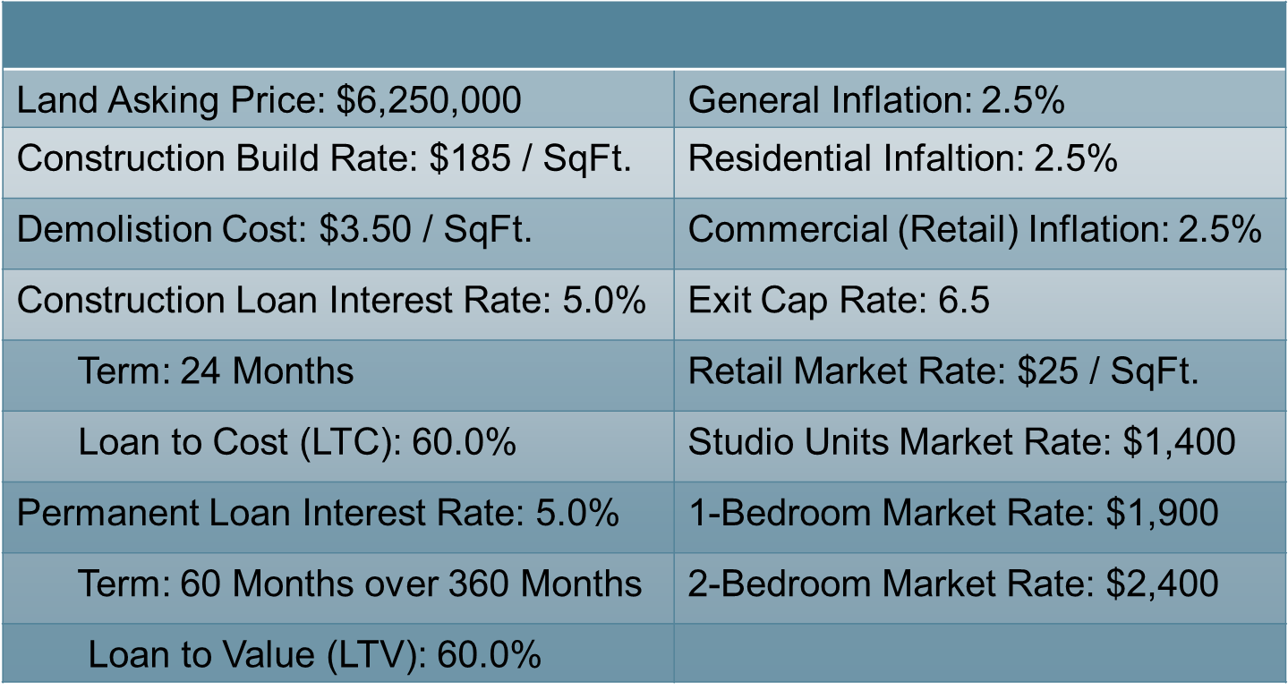
Current market condition & initial assumptions

Slide 39
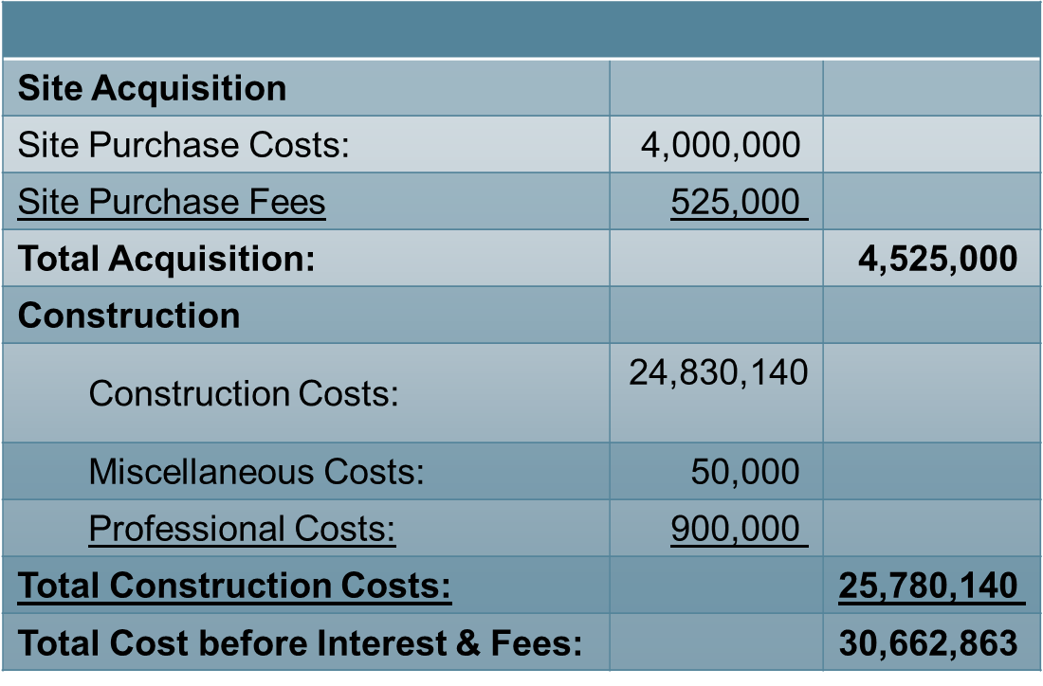
Development cost

Slide 40
All in development cost

Slide 41
Investment valuation

Slide 42
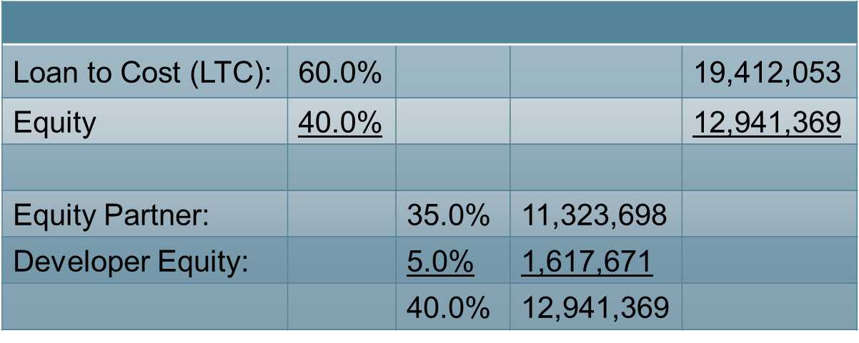
The ask:

Slide 43
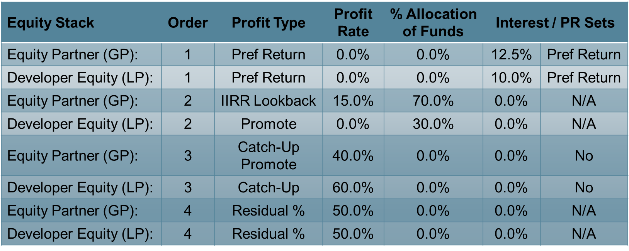
Deal structure

Slide 44
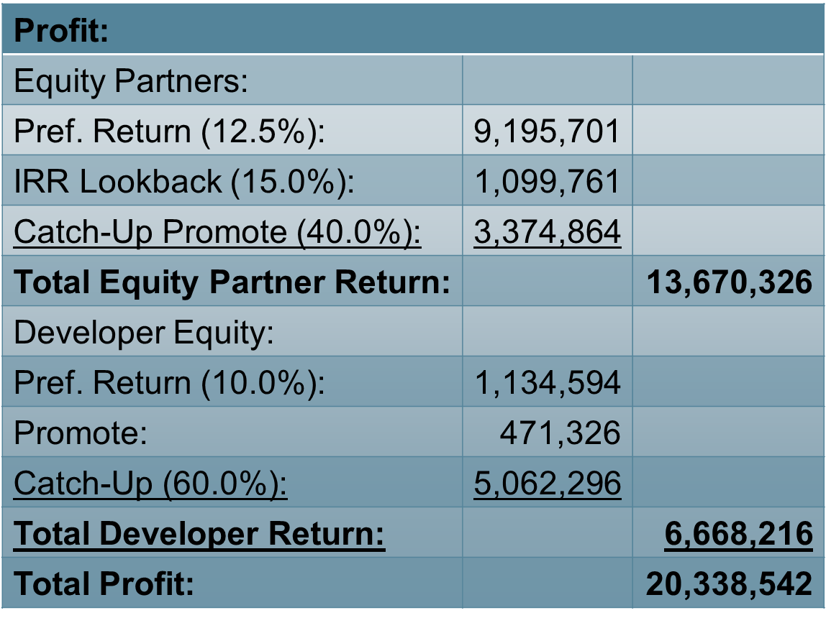
Profit distribution per equity stake

Slide 45
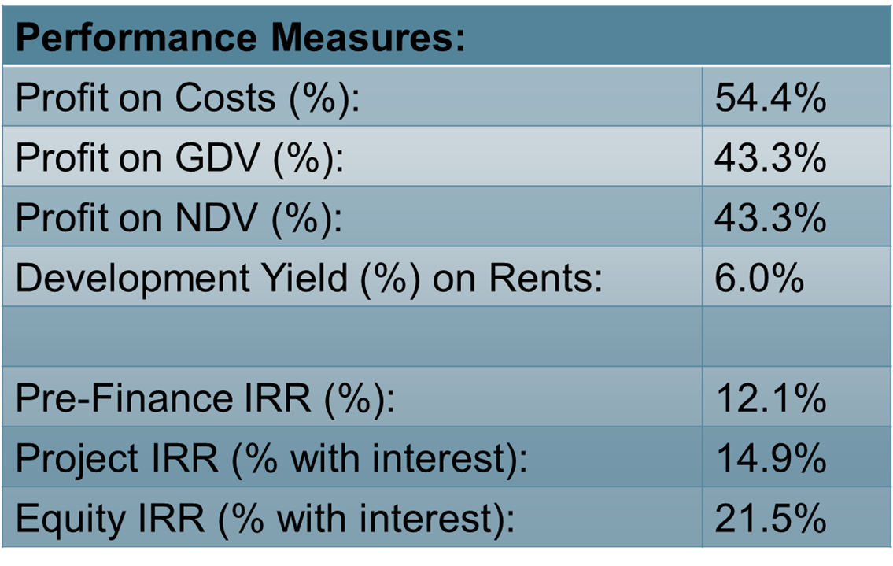
Conclusion

Slide 46
Thank you
Connor Nitterauer, Adam Franklin, Kashane Tiger, Kenny Cedeno

